Slide 1
Obstetric Airway Management
Dariush Abtahi, MD
Assistant Professor of Anesthesia, SBMU
Imam Hossein General Hospital
http://drdariush.me/PowerPoints/Obstetric%20Airway%20Management.pptx

Slide 2
⬆︎ risk of failed tracheal intubation during GA:
clinical factors
situational factors
human factors
Difficult intubation:
1 in 21 obstetric intubations
1 in 50 non-obstetric intubations
Incidence of failed / difficult obstetric intubation:
not changed for more than 40 years
failed: 2.6/1000 obstetric GA (1 in 390)
associated maternal mortality: 2.3/100000 GA (1 death / 90 failed intubations)

Slide 3
WHY IS OBSTETRIC AIRWAY MANAGEMENT MORE DIFFICULT?
Anatomical and Physiological Factors
Significant independent predictors of failed tracheal intubation:
age
body mass index
Mallampati score

Slide 4
WHY IS OBSTETRIC AIRWAY MANAGEMENT MORE DIFFICULT?
Anatomical and Physiological Factors
 | Anatomical and Physiological Changes | Clinical Consequences
Airway | ⬆︎ Weight in pregnancy ⬆︎ breast size ⬆︎ vascularity/edema of the airway mucosa | Difficulty with positioning Difficulty with laryngoscope insertion ⬆︎ risk of airway bleeding/potential difficulty with tracheal intubation
Respiratory | ⬇︎ functional residual capacity | ⬆︎ rate of oxygen desaturation
Metabolic | ⬆︎ oxygen consumption (⬆︎ metabolic demand) | ⬆︎ rate of oxygen desaturation
GI | ⬇︎ lower esophageal sphincter tone Delayed gastric emptying | ⬆︎ risk of gastric regurgitation / pulmonary aspiration

Slide 5
WHY IS OBSTETRIC AIRWAY MANAGEMENT MORE DIFFICULT?
Human Factors
situation awareness: failures to anticipate, wrong decision
job factors: task difficulty; staffing, time pressure
person factors: tiredness, hunger, stress
protective factors: teamwork, communication
⬇︎ frequency of obstetric GA ⇒ ⬇︎ experience
Time constraints in emergency setting ⇒ inadequate airway assessment/patient positioning
⬆︎ risk of difficult/failed intubation in this patient group ⇒ ⬆︎ anxiety/erode confidence

Slide 6
PRACTICAL APPROACH TO OBSTETRIC AIRWAY MANAGEMENT
Planning and Preparation for Safe Obstetric GA
Important components of safe obstetric airway management:
adequate/timely airway assessment
fasting status
pharmacologic aspiration prophylaxis
optimal patient positioning
adequate preoxygenation
provision of a secure airway

Slide 7
PRACTICAL APPROACH TO OBSTETRIC AIRWAY MANAGEMENT
Airway Assessment
Every woman undergoing obstetric surgery should have a documented airway assessment- highlight potential difficulties
 | Tracheal Intubation | Face Mask Ventilation | SAD Insertion | Front-of-Neck Access
Body mass index >35 kg/m2 | * | * | * | *
Neck circumference >50 cm | * | * | * | *
Thyromental distance <6 cm | * | * | *
Cricoid pressure | * | * | *
Mallampati grade 3-4 | * | *
Fixed cervical spine flexion deformity | * |  |  | *
Dentition problems | * |  | *
Miscellaneous (obstructive sleep apnoea, reduced lower jaw protrusion, airway oedema) | * | *
Mouth opening ,4 cm | *

Slide 8
PRACTICAL APPROACH TO OBSTETRIC AIRWAY MANAGEMENT
Airway Assessment
Every woman undergoing obstetric surgery should have a documented airway assessment- highlight potential difficulties
https://clinicalexcellence.qld.gov.au/sites/default/files/docs/clinical-networks/difficult-airway-alert.pdf
https://clinicalexcellence.qld.gov.au/sites/default/files/docs/clinical-networks/difficult-airway-alert-support.pdf

Slide 9
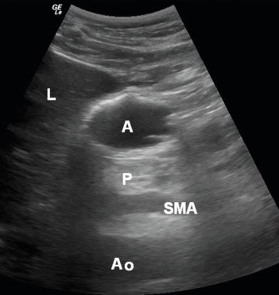
PRACTICAL APPROACH TO OBSTETRIC AIRWAY MANAGEMENT
Pulmonary Aspiration Risk Reduction
⬇︎ Gastric emptying by labour / opioid analgesia
H2-receptor antagonist (ranitidine) + antacid (sodium citrate) ⇒⬆︎ gastric acid pH
Ultrasound assessment of gastric contents ???

Slide 10
PRACTICAL APPROACH TO OBSTETRIC AIRWAY MANAGEMENT
Patient Positioning
Optimal patient positioning: essential prior to induction of GA
Aligning the external auditory meatus with the supra-sternal notch.
20-30 degree head-up position:
facilitate laryngoscopy
improve the view of the glottis
⬆︎ functional residual capacity (FRC)
⬇︎ the risk of gastric regurgitation

Slide 11
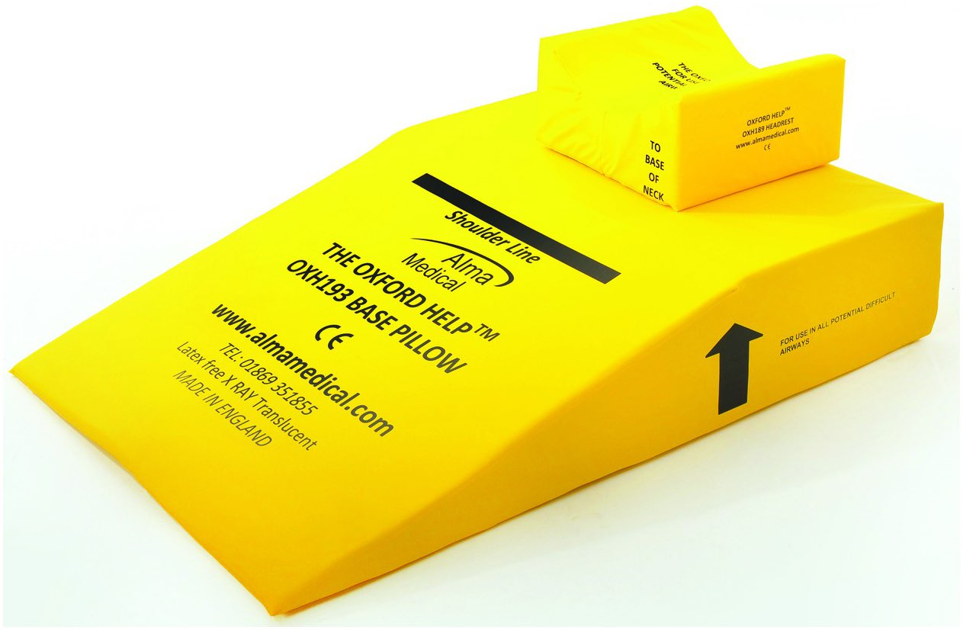
PRACTICAL APPROACH TO OBSTETRIC AIRWAY MANAGEMENT
Patient Positioning
Specific equipment (Oxford HELP Pillow; Alma Medical, London, UK)

Slide 12
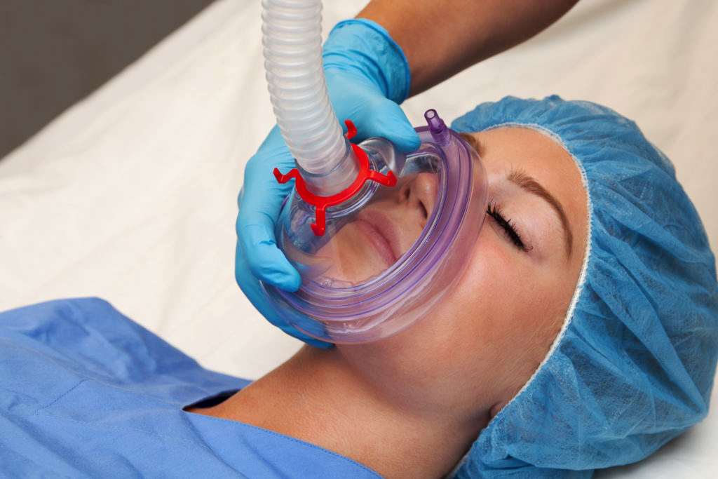
PRACTICAL APPROACH TO OBSTETRIC AIRWAY MANAGEMENT
Preoxygenation
Effective preoxygenation delays desaturation following induction of GA:
Fresh gas flows > 10 L/min
tight-fitting face mask
In emergency situation: 3 - 4 maximal capacity breaths of 100% O2 (effective as 3 minutes of normal tidal breathing)

Slide 13
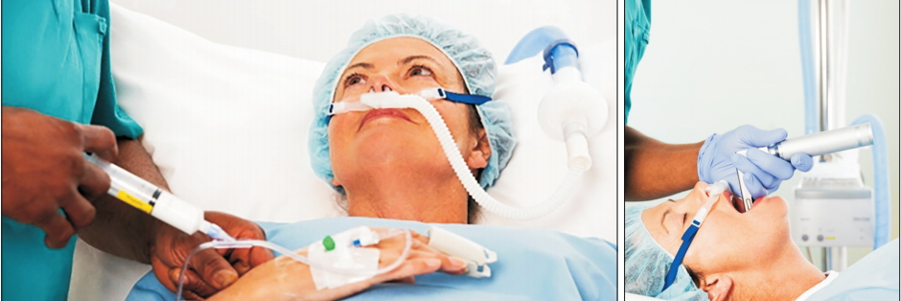
PRACTICAL APPROACH TO OBSTETRIC AIRWAY MANAGEMENT
Preoxygenation
Insufflation of oxygen at 5 L/min via nasal cannula during intubation attempts.
Delivery of high-flow humidified nasal oxygen (transnasal humidified rapid insufflation ventilatory exchange; THRIVE).

Slide 14
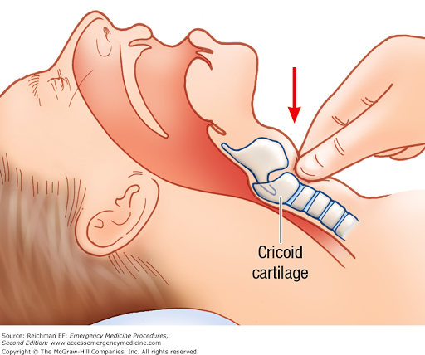
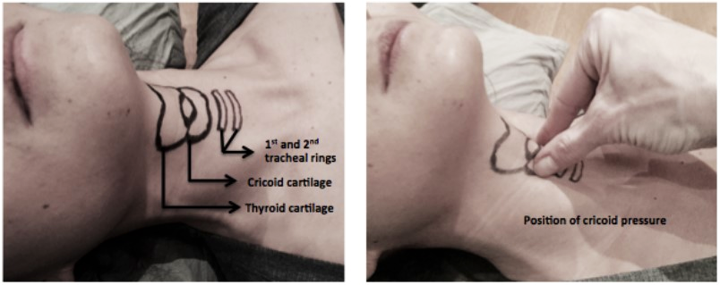
PRACTICAL APPROACH TO OBSTETRIC AIRWAY MANAGEMENT
Cricoid Pressure
Application of CP during RSI for an obstetric GA
Limited evidence
Cricoid pressure (CP): controversial

Slide 15
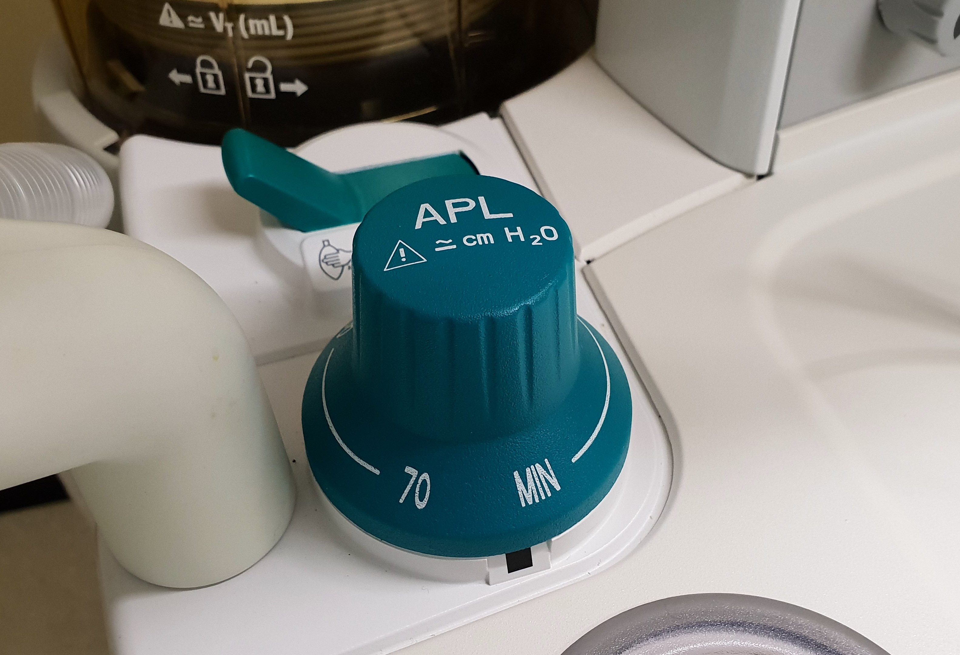
PRACTICAL APPROACH TO OBSTETRIC AIRWAY MANAGEMENT
Face Mask Ventilation Prior to Tracheal Intubation
Face mask ventilation following RSI has traditionally been avoided because of the fear of gastric insufflation and risk of regurgitation.
Gentle face mask ventilation (inflation pressure <20 cm H2O + CP) has been recommended in recent guidelines.

Slide 16
PRACTICAL APPROACH TO OBSTETRIC AIRWAY MANAGEMENT
Elective Use of SADs for Cesarean Section
Tracheal intubation following RSI is generally recommended
Reports of the elective use of SADs in fasted patients undergoing elective cesarean section.

Slide 17
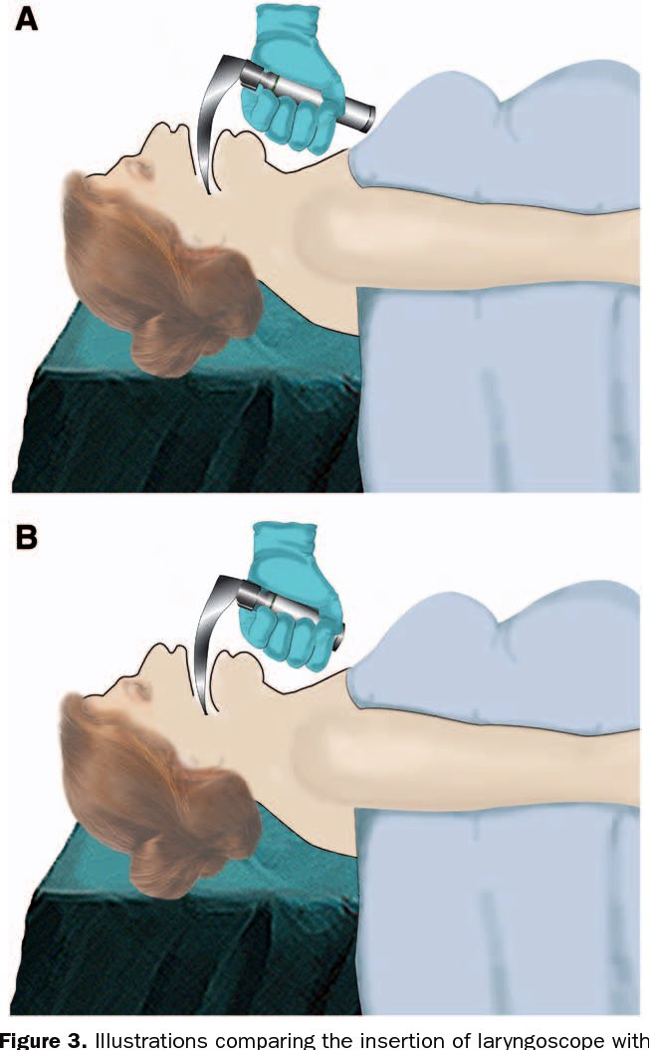
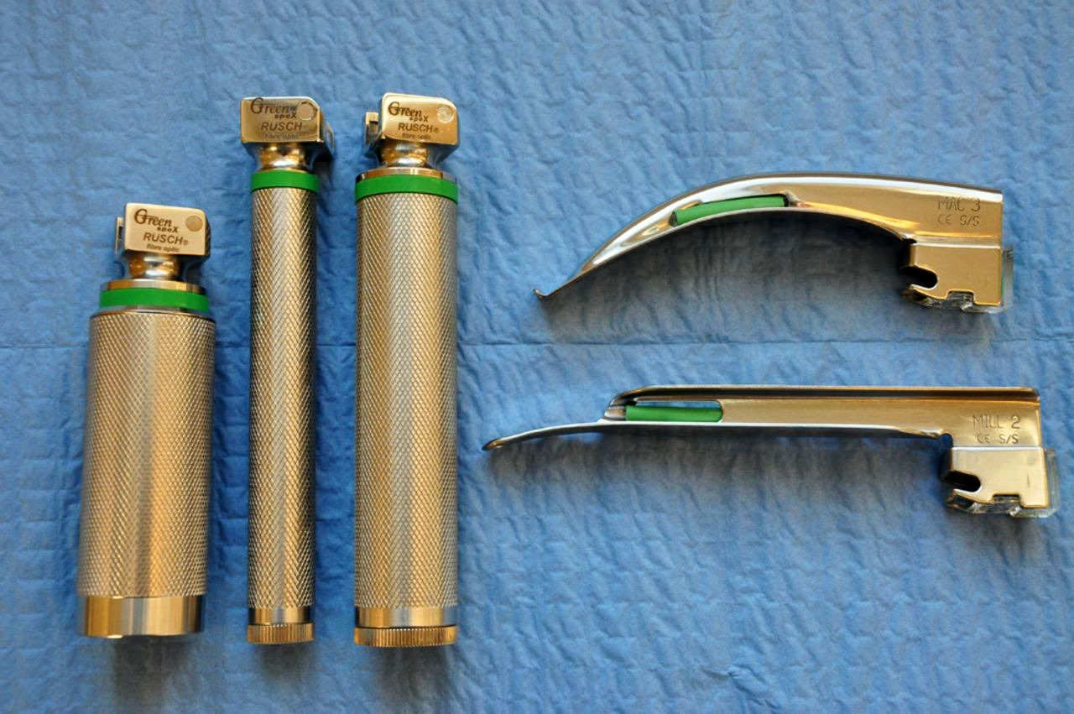
PRACTICAL APPROACH TO OBSTETRIC AIRWAY MANAGEMENT
Direct / Indirect (Video) Laryngoscopy
Direct laryngoscopy using a standard laryngoscope
A short-handled laryngoscope should be available for pregnant women

Slide 18
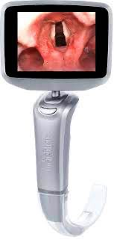
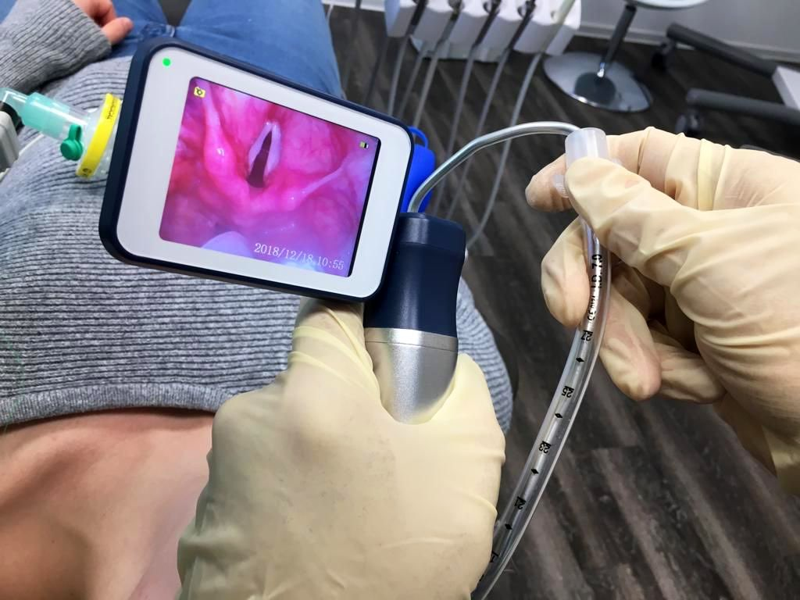
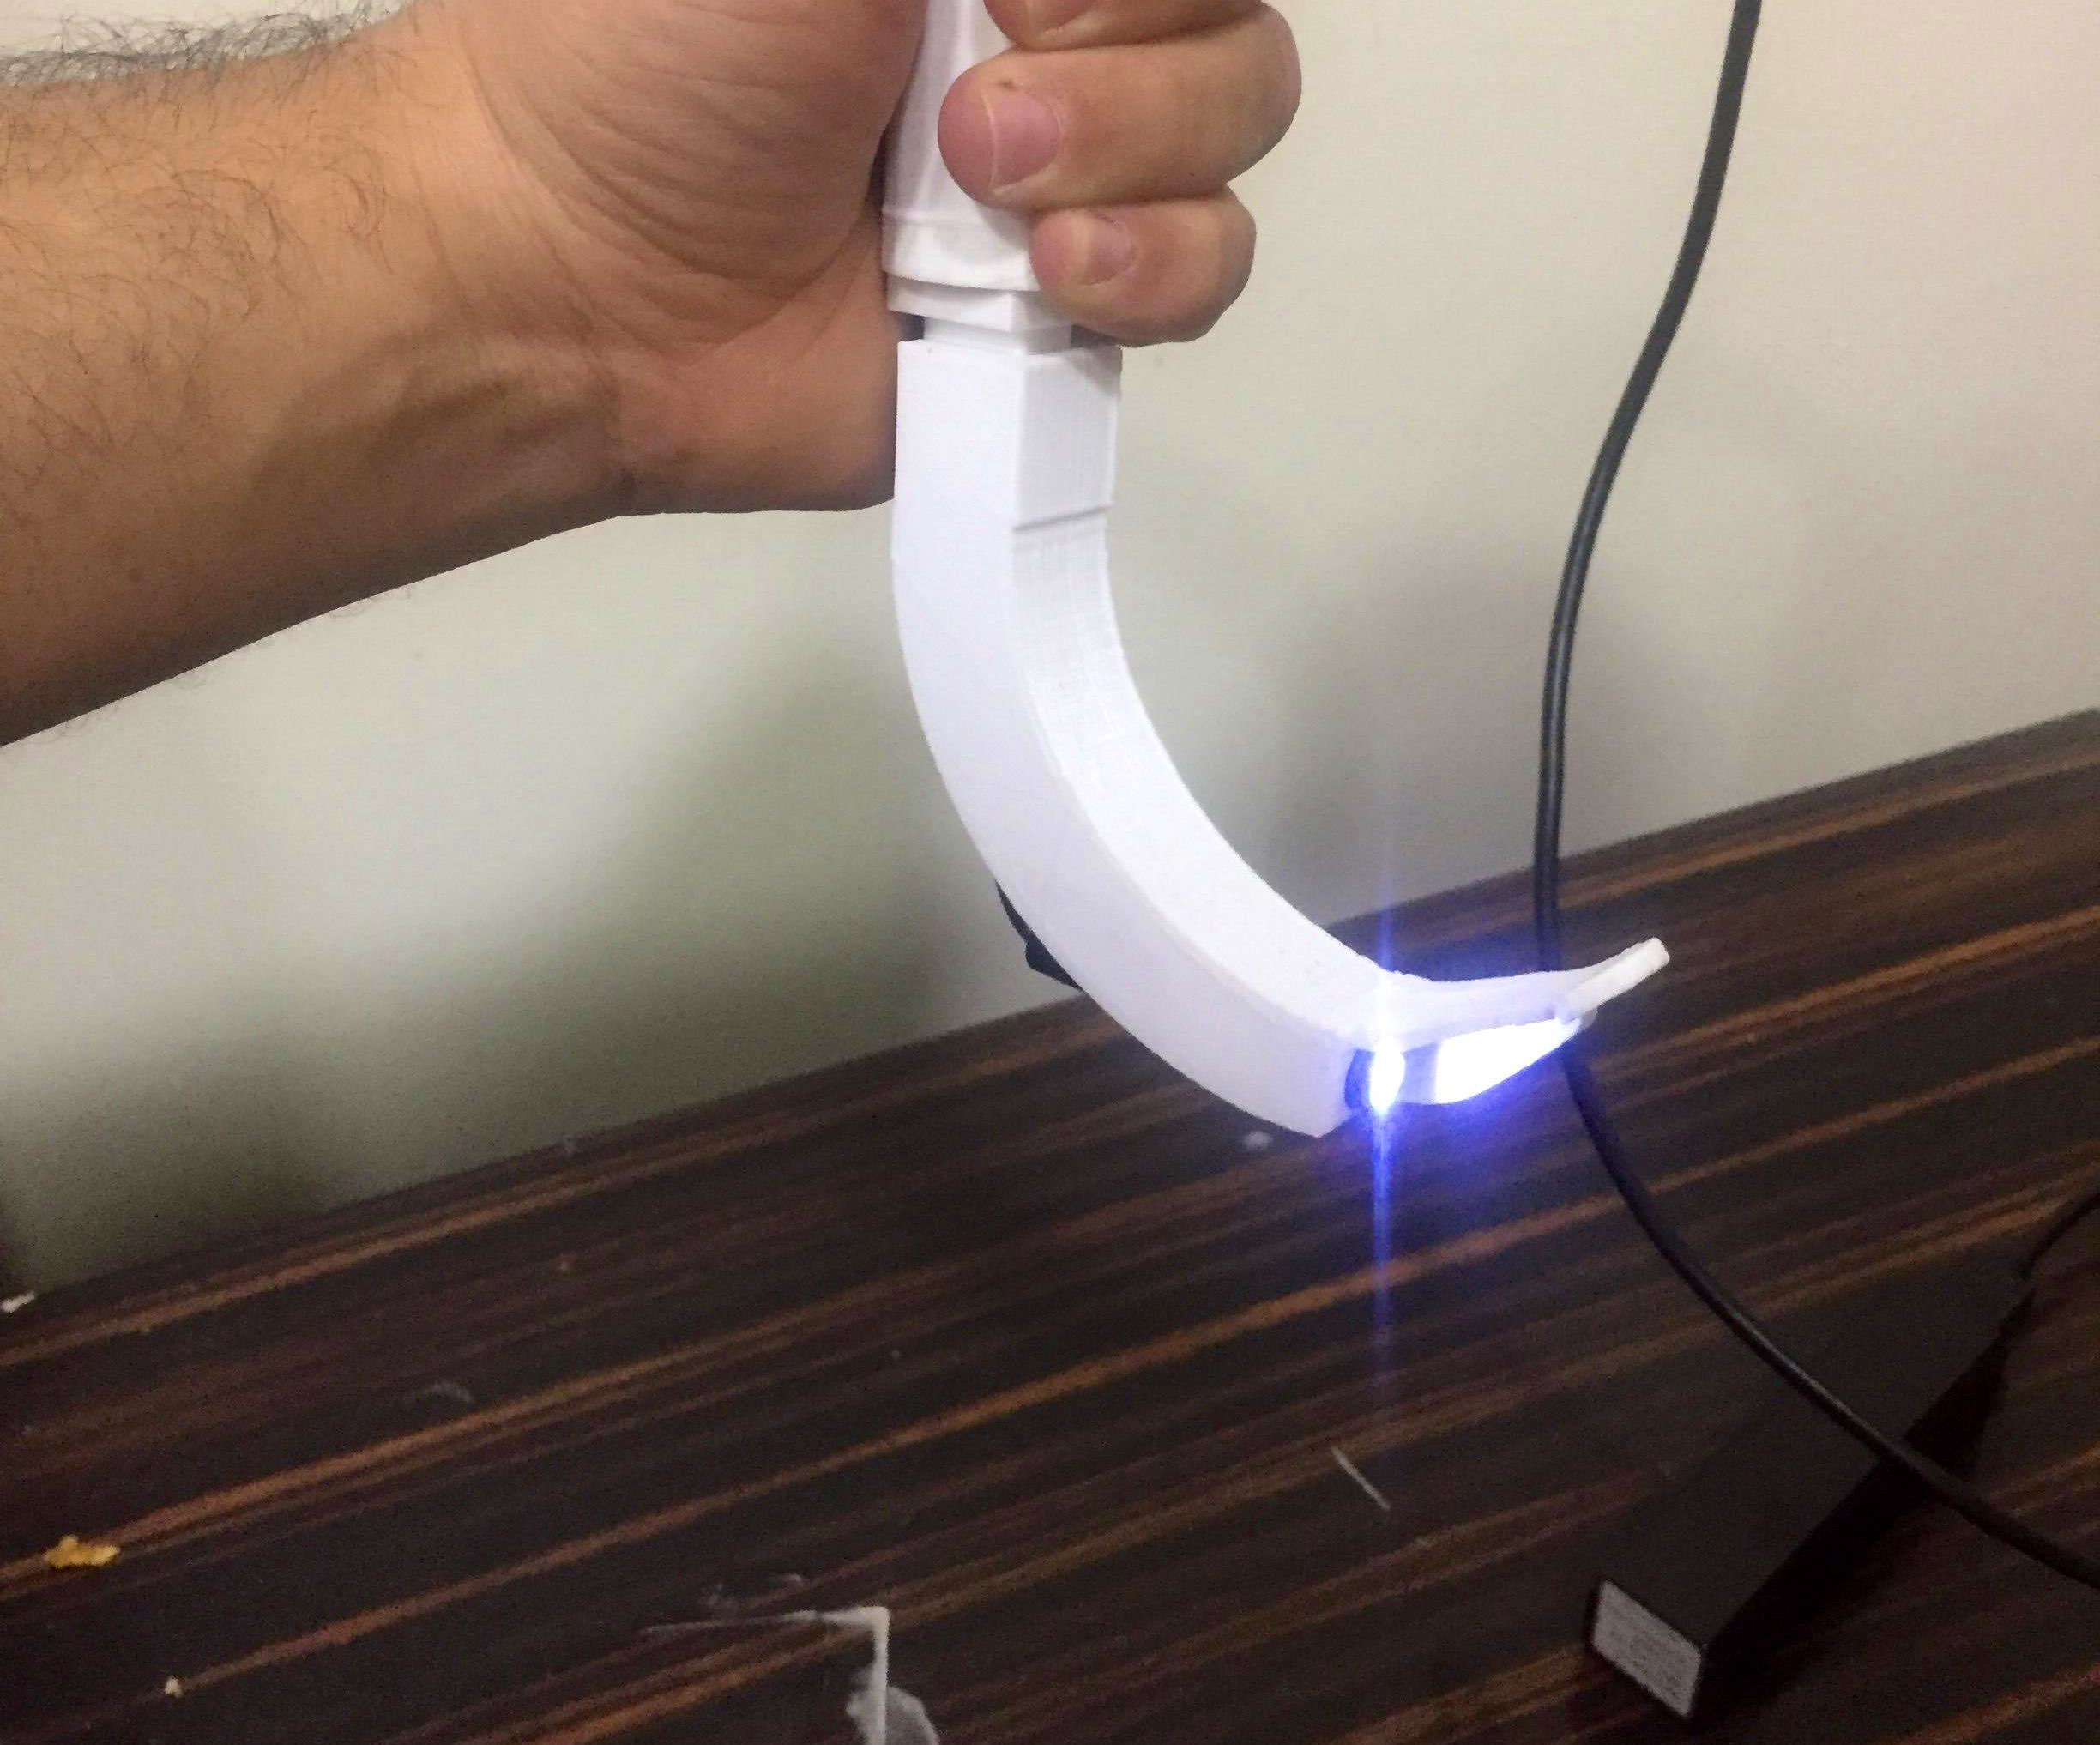
PRACTICAL APPROACH TO OBSTETRIC AIRWAY MANAGEMENT
Direct / Indirect (Video) Laryngoscopy
Current guidelines recommend that a videolaryngoscope be immediately available for all obstetric GAs.

Slide 19
MANAGEMENT OF THE ANTICIPATED DIFFICULT AIRWAY
If a patient is identified with predictors of a potentially difficult airway, the patient should be reviewed as soon as possible.
Contingency plans should be considered in the event the woman presents in the after-hours period requiring an emergency intervention.
The plan should be discussed with the obstetric team.

Slide 20
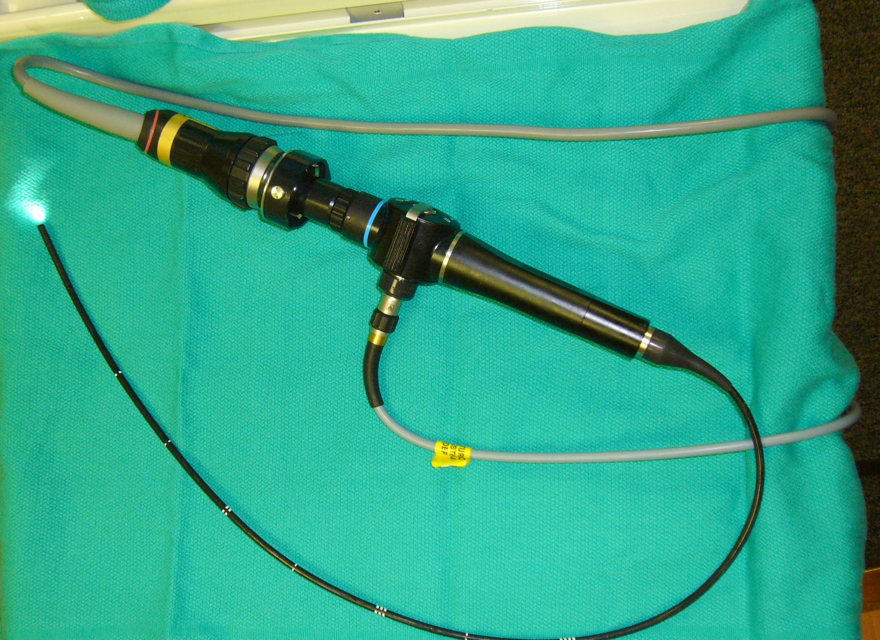
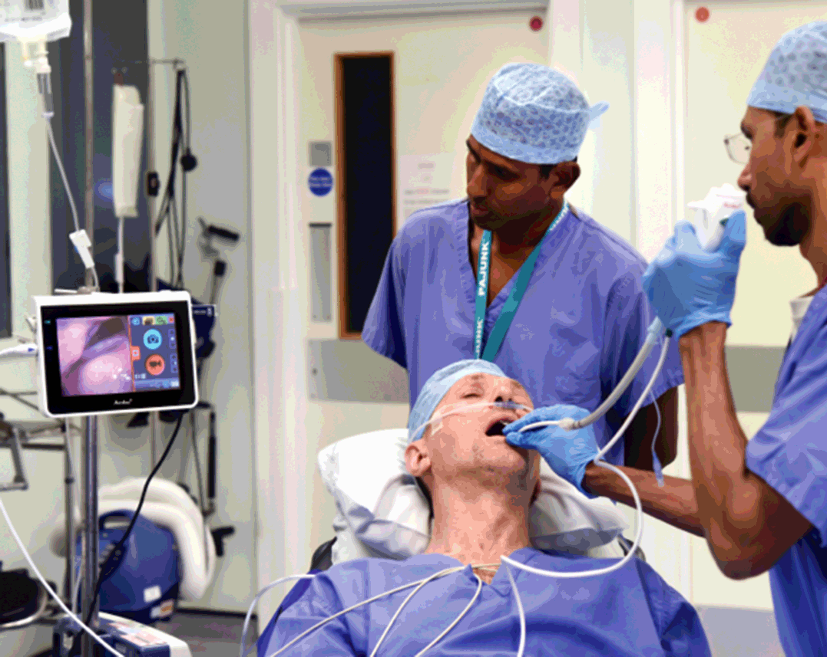
MANAGEMENT OF THE ANTICIPATED DIFFICULT AIRWAY
Awake fiberoptic intubation is more easily performed in a controlled environment with a cooperative patient.
Attempting this technique in the often chaotic and stressful setting of an emergency cesarean section can be challenging.

Slide 21
MANAGEMENT OF THE UNANTICIPATED DIFFICULT AIRWAY
If a poor view of the larynx is obtained during the first intubation attempt, measures to improve the view should be performed:
changing the position of the patient’s head and neck
decreasing, readjusting, or releasing CP
If passage of the endotracheal tube is problematic:
bougie or stylet
an endotracheal tube of smaller diameter
The most experienced anesthesiologist present should perform the second intubation attempt.
A third intubation attempt can be considered and attempted by an experienced provider only.

Slide 22
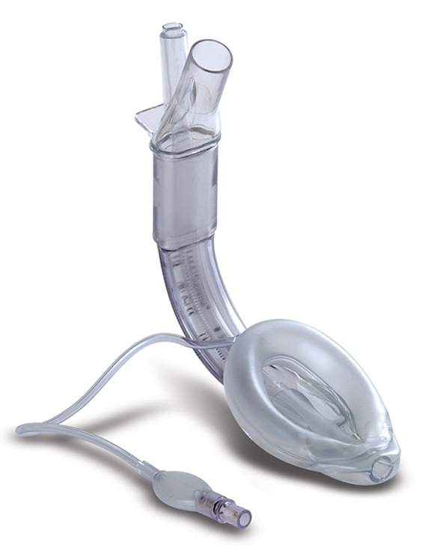
Failed Intubation
Following declaration of a failed intubation, oxygenation via face mask / SAD should be prioritized + avoid awareness + aspiration
If face mask ventilation is inadequate ⇒ insertion of a second-generation SAD
A maximum of two attempts at SAD insertion are recommended to avoid oropharyngeal trauma such as bleeding and/or edema.

Slide 23
Can’t Intubate, Can’t Oxygenate
If adequate oxygenation cannot be achieved via face mask / SAD.
ENT surgeon / intensivist for front-of-neck airway access
If front-of- neck access is unsuccessful → cardiac arrest is likely → maternal ALS
perimortem cesarean section

Slide 24
Front-of-Neck Access Techniques
Emergency front-of-neck access:
Cannula cricothyroidotomy technique
Scalpel cricothyroidotomy technique- using the scalpel to make a transverse stab incision through the skin and cricothyroidotomy membrane before placing a bougie into the trachea over which a tracheal tube can be passed (recommended)
Suitable equipment should be immediately available
All anesthesiologists should be trained and competent in this emergency procedure.

Slide 25
Front-of-Neck Access Techniques
Cannula cricothyroidotomy technique

Slide 26
Front-of-Neck Access Techniques
Scalpel cricothyroidotomy technique

Slide 27
To Wake or Proceed With Surgery
Waking → may not always be the optimal course of action if maternal and/or fetal life is at risk
In elective setting, with no risk to either mother or fetus- may be the correct decision
The decision will depend on:
clinical judgment of the anesthesiologist
discussion with the obstetric team
anesthesiologist’s individual skills / confidence
evolving situation

Slide 28
To Wake or Proceed With Surgery
If the decision is made to proceed:
surgery should be performed by the most senior member of the obstetric team
fundal pressure minimized at delivery to reduce the risk of gastric emptying and/or impairment of ventilation
Airway management may become easier once the fetus has been delivered:
⬇︎ in maternal oxygen consumption
⬇︎ intra-abdominal pressure⇒ ⬆︎ pulmonary compliance
Use a non-irritant volatile agent (sevoflurane)

Slide 29
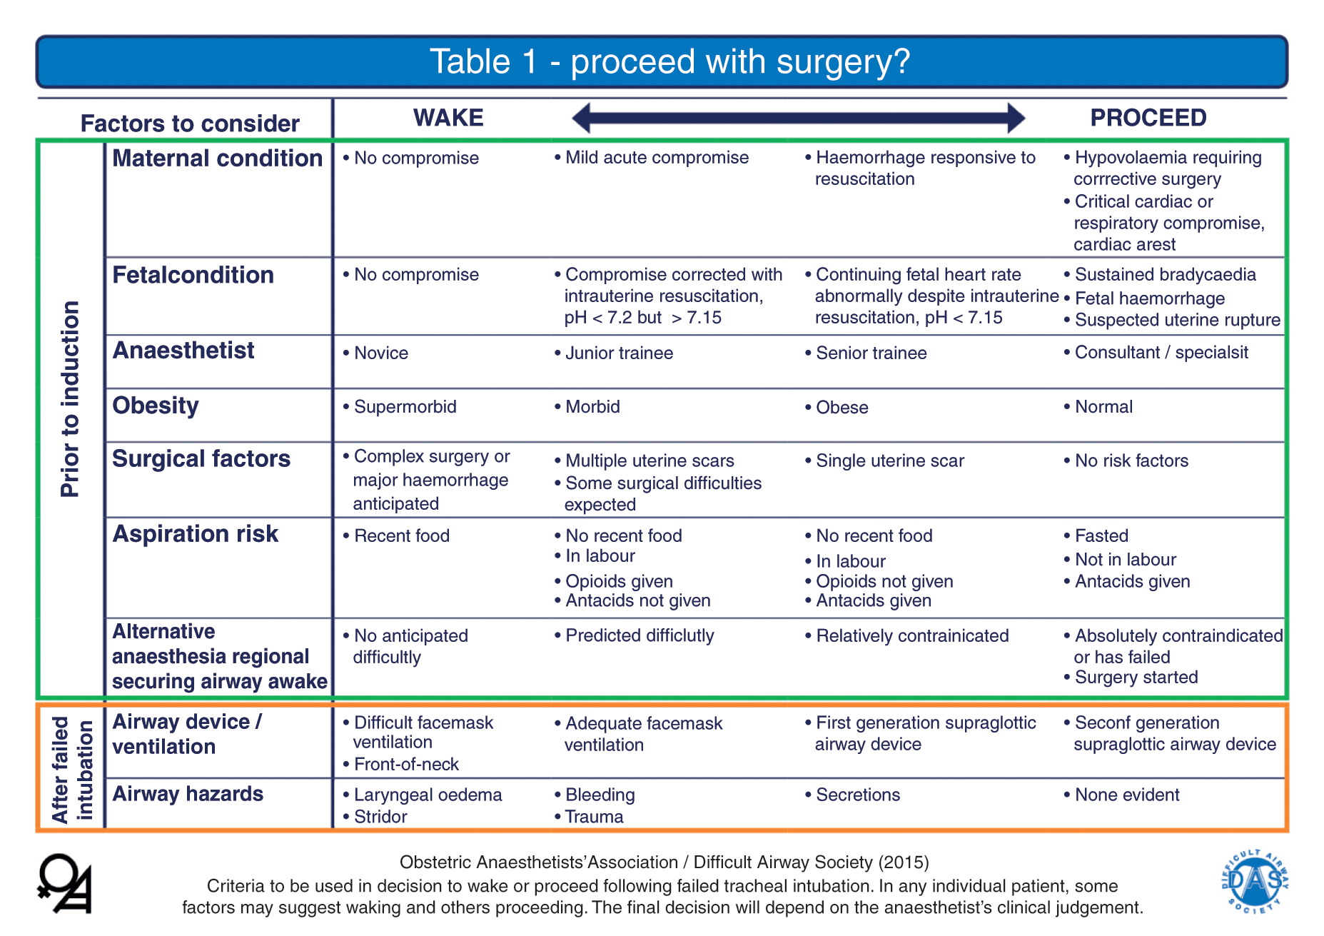

Slide 31
EXTUBATION AND POSTOPERATIVE CARE
Focus on airway management must continue until the patient has recovered from GA and is able to maintain their own airway.
The anesthesiologist should remain vigilant, and the obstetric patient should be extubated awake in the left lateral or head-up position with full reversal of neuromuscular blockade.

Slide 32
References
Quinn AC, Milne D, Columb M, Gorton H, Knight M. Failed tracheal intubation in obstetric anaesthesia: 2 yr national case- control study in the UK. Br J Anaesth. 2012:110:74-80.
Flin R, Fioratou E, Frerk C, Trotter C, Cook TM. Human factors in the development of complications of airway management: preliminary evaluation of an interview tool. Anaesthesia. 2013;68:817-825.
Van de Putte P, Perlas A. Ultrasound assessment of gastric content and volume. Br J Anaesth 2014;113:12-22.
Collins JS, Lemmens JM, Brodsky JB, Brock-Utne JG, Levitan RM. Laryngoscopy and morbid obesity: a comparison of the ‘‘sniff’’ and ‘‘ramped’’ positions. Obes Surg. 2004;14:1171-1175.
https://das.uk.com/guidelines/obstetric_airway_guidelines_2015
Mushambi MC, Kinsella SM, Popat M, et al. Obstetric Anaesthetists' Association and Difficult Airway Society guidelines for the management of difficult and failed tracheal intubation in obstetrics. Anaesthesia. 2015;70(11):1286-1306. doi:10.1111/anae.13260
https://resources.wfsahq.org/atotw/obstetric-airway-management/
https://clinicalexcellence.qld.gov.au/priority-areas/clinician-engagement/statewide-clinical-networks/anaesthesia-and-perioperative-1
Osman, A., Sum, K.M. Role of upper airway ultrasound in airway management. j intensive care 4, 52 (2016). https://doi.org/10.1186/s40560-016-0174-z

Slide 33
Mother
Shahrad Malek Fazeli

